Slide 1
Fresh Grads – Group Project
Hotel Bookings Management System

Slide 2
Problem Statement
To Create an Application for Hotel Booking Management System
Customer should be able to view the list of hotels, rooms available.
Customer should be able to book the rooms of the hotel.
Admin should be able to perform below operations:
1.Hotel Management
2.Rooms management
3. Payments

Slide 3
Road Map
Application will be developed in following Sprints –
Core Java +JPA with Hibernate
Spring Boot + Rest Controller + JPA with Hibernate
Angular for UI design (Front End) + Integration with previous Sprint

Slide 4
Plan
Design
Generate the skeleton as per class design provided
TDD approach
Identify test cases for each module
Write Failing Test cases
Convert the Test Cases in GREEN
Implement the case study in incremental manner

Slide 5
Modules
Login Module
Customer Module
Hotel
Management Module
Rooms Management Module
Rooms Booking
Management Module
Payments
Management module

Slide 6
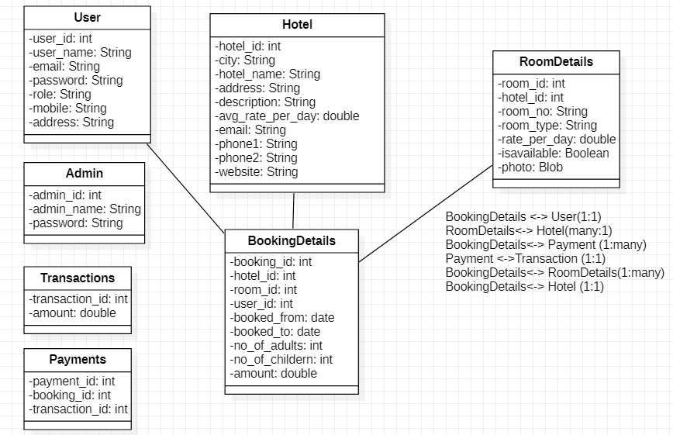
Class Design
POJO Classes:

Slide 7
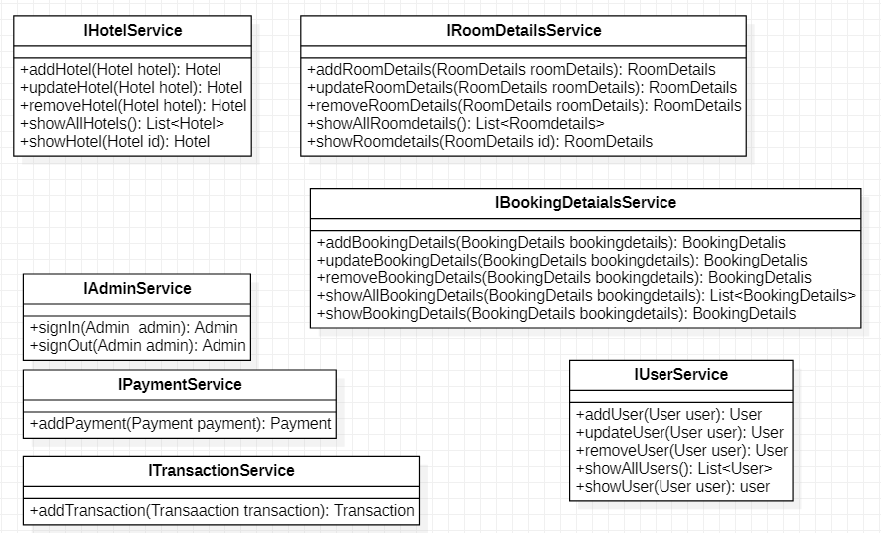
Class Design
Service Interface:

Slide 8
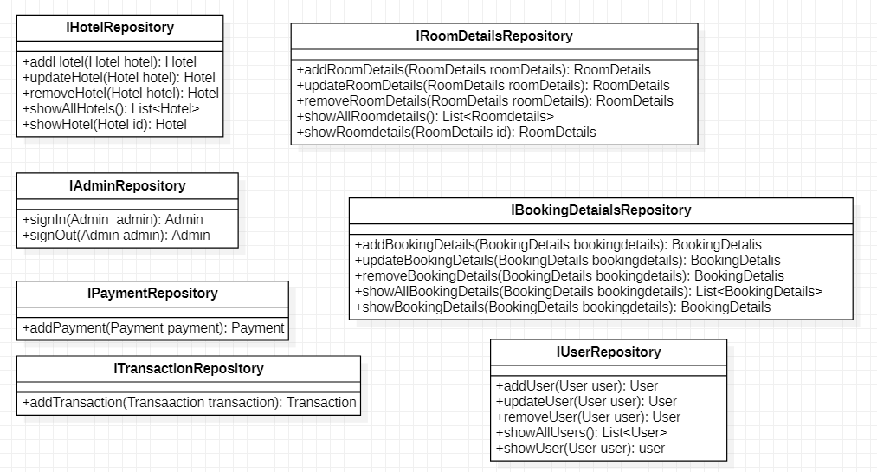
Class Design
Repository:

Slide 9




Questions

